Slide 1
2011 Conaway conference
Army Corps of Engineers
404 Permit compliance inspections

Slide 2
ACOE Compliance Inspections 2010
ODOT Funded ACOE Columbus Office Staff
ACOE Policy to give notice prior to field visit coordinated through Central Office
Random projects or complaint driven selection
14 projects visited in 2010

Slide 3
Federal Requirement
Annual Budget Justification is based on several internal auditing elements
A representative amount of 404 Compliance inspections are required annually

Slide 4
Key Players
Army Corps of Engineers 404 Columbus ODOT Office
Pete Clingan
Bret Latta
Tim Long
Ohio EPA 401 WQC Unit
Art Coleman
Federal Fish and Wildlife
Karen Hallberg
State Historic Preservation Office
Tom Grooms
Nancy Campbell

Slide 5
Complaint Driven Inspection

Slide 6
Complaint Driven Inspection

Slide 7
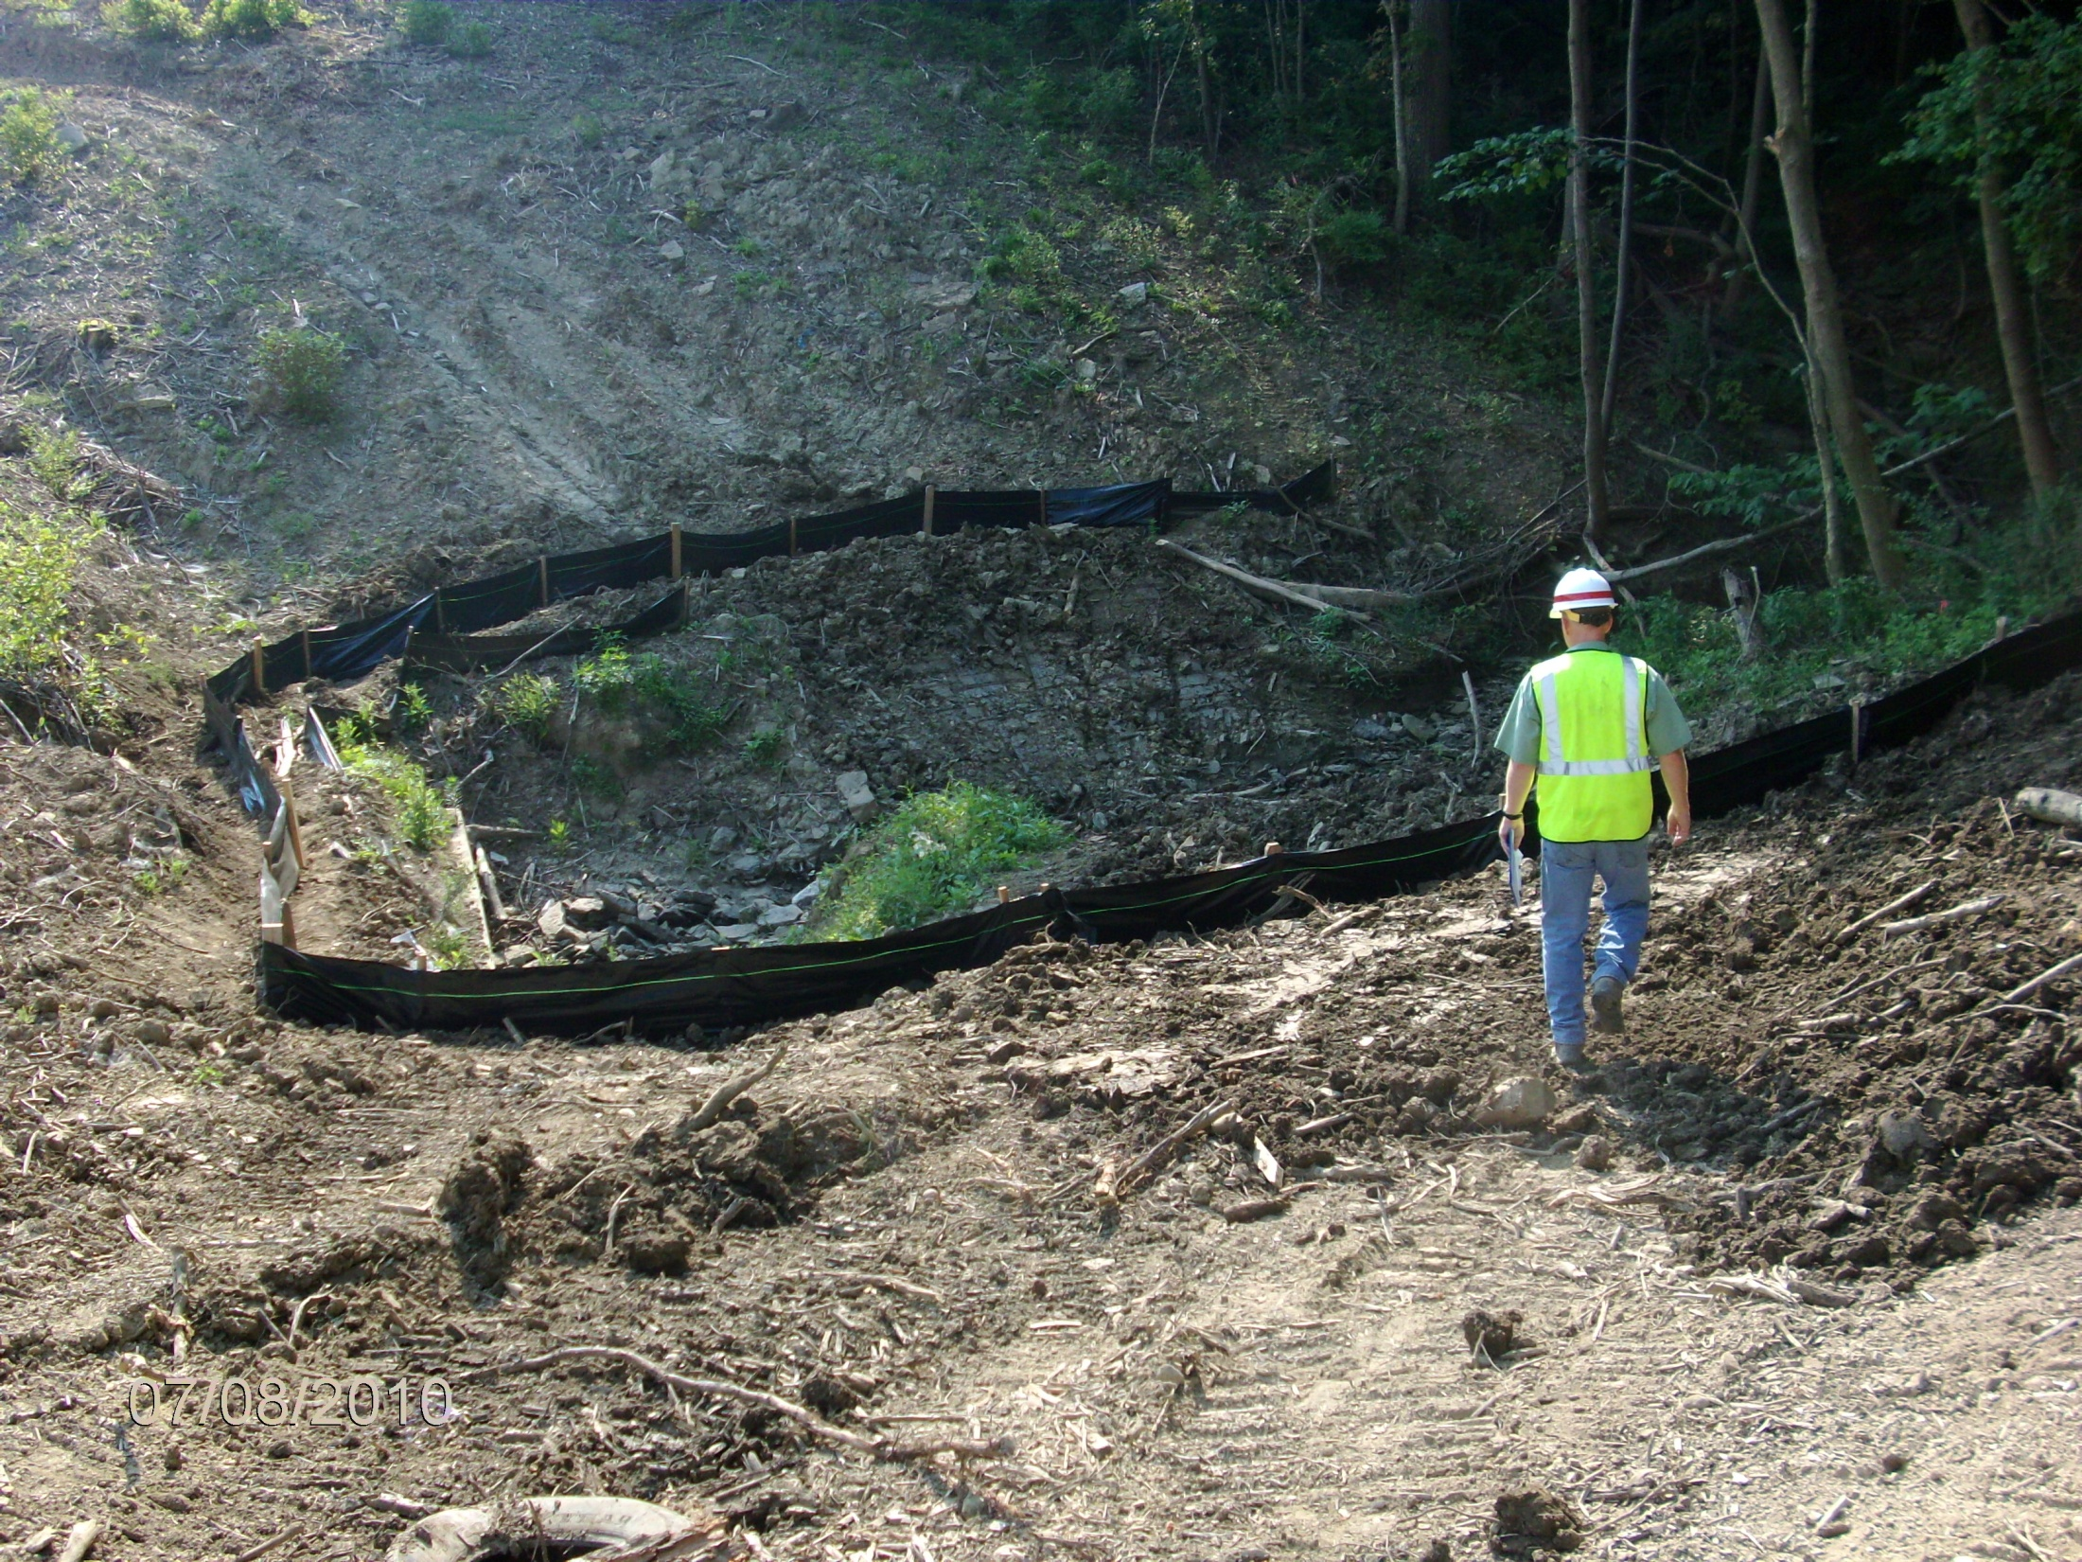
Typical Inspection Findings
Silt fence application appropriate for type of work.
Access to the stream work will require additional prep. Equipment is not permitted to work in or from the jurisdictional waterway.

Slide 8
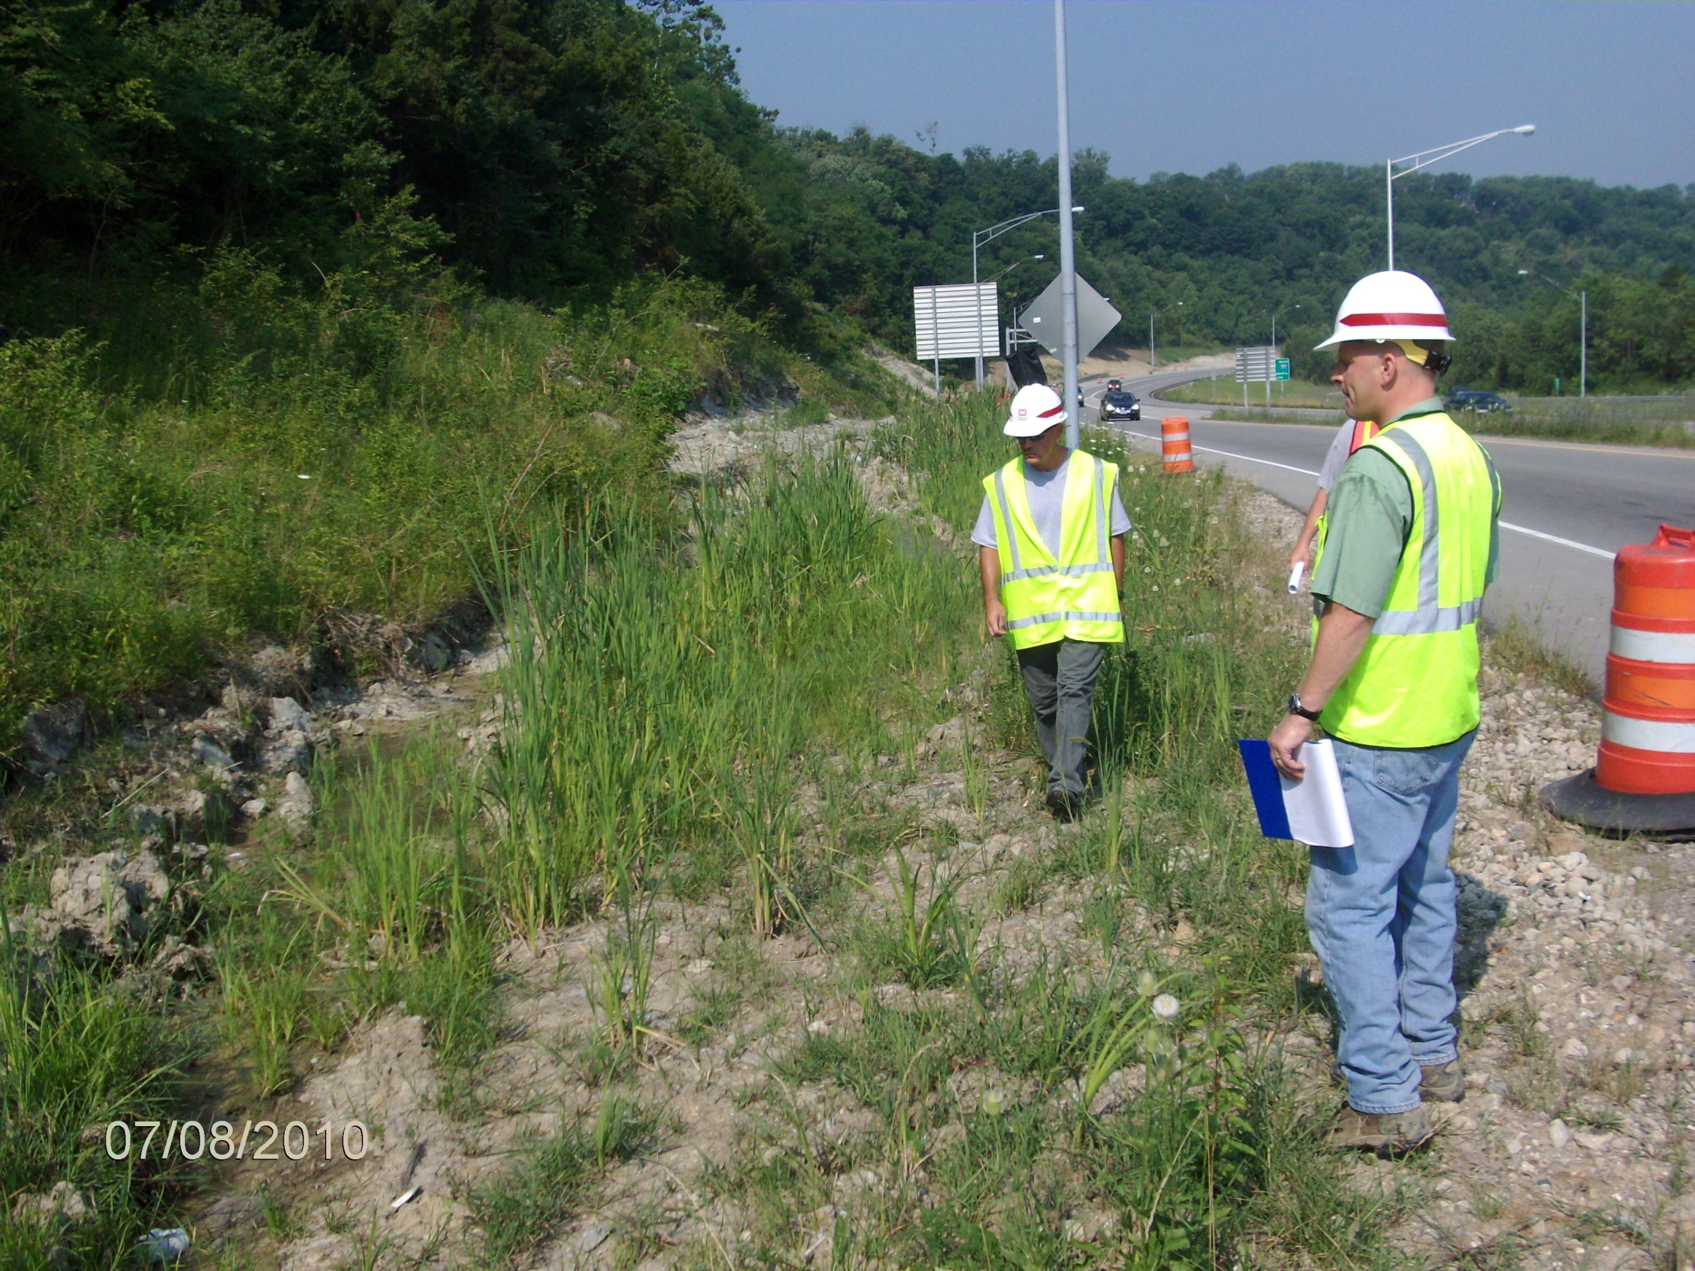
This small wetland area is at the head of the project drainage.
The area has been disturbed by construction activity.
Perimeter controls are needed to prevent the discharge of sediment from the construction activity to the wetland.

Slide 9
Problems With Compliance
Contractor and Project Staff worked together to modify the 404 permit
ACOE expedited the Permit Modification
It was evident from the site conditions that the permit requirements were disregarded

Slide 10
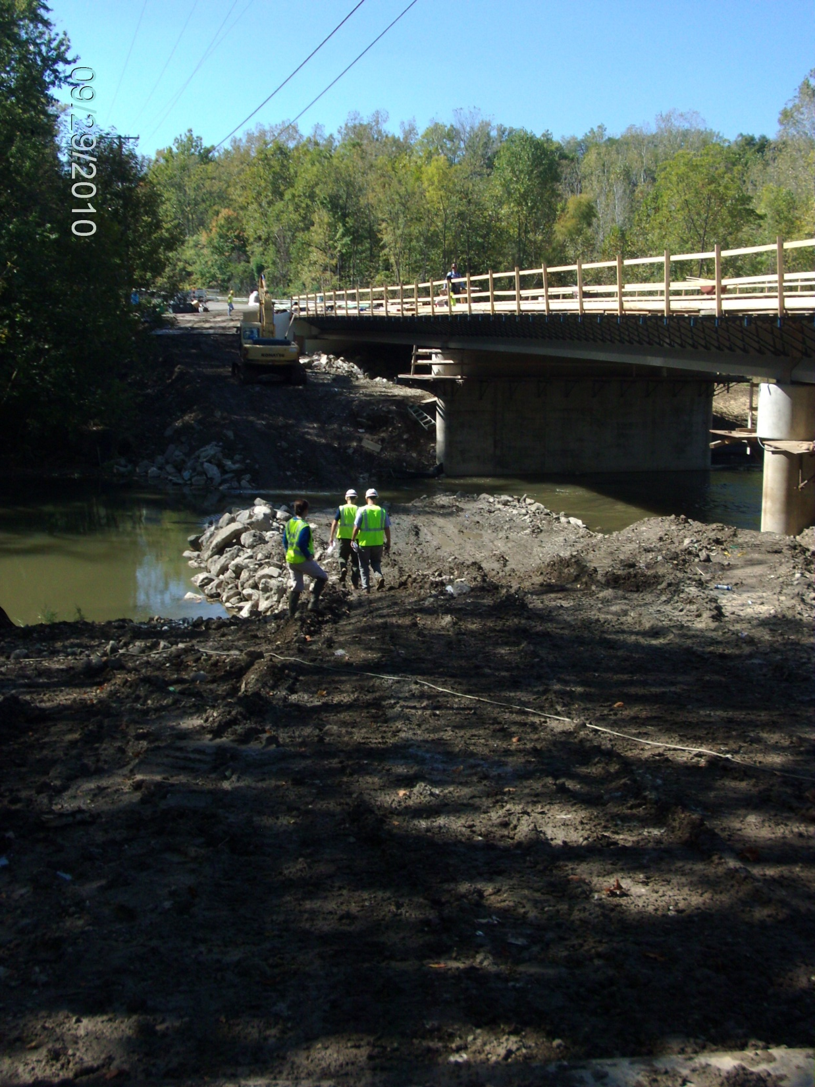
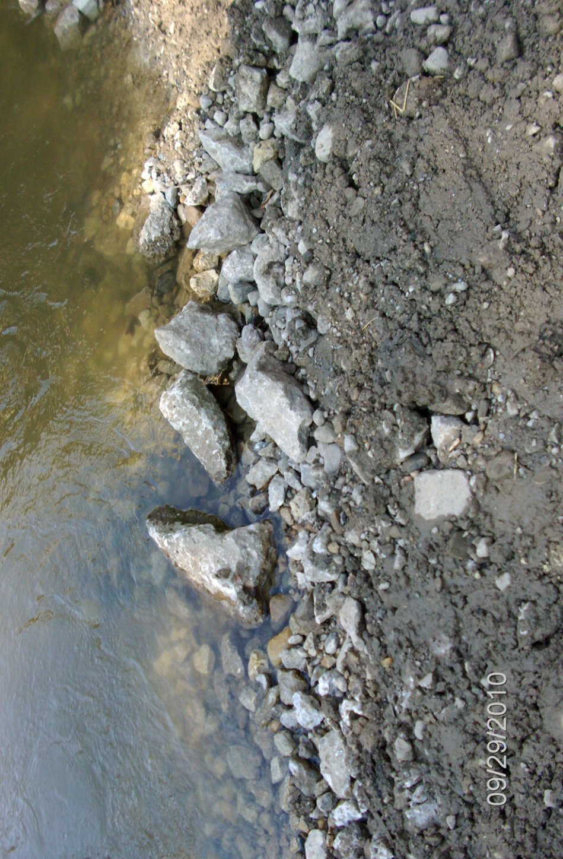

Slide 11
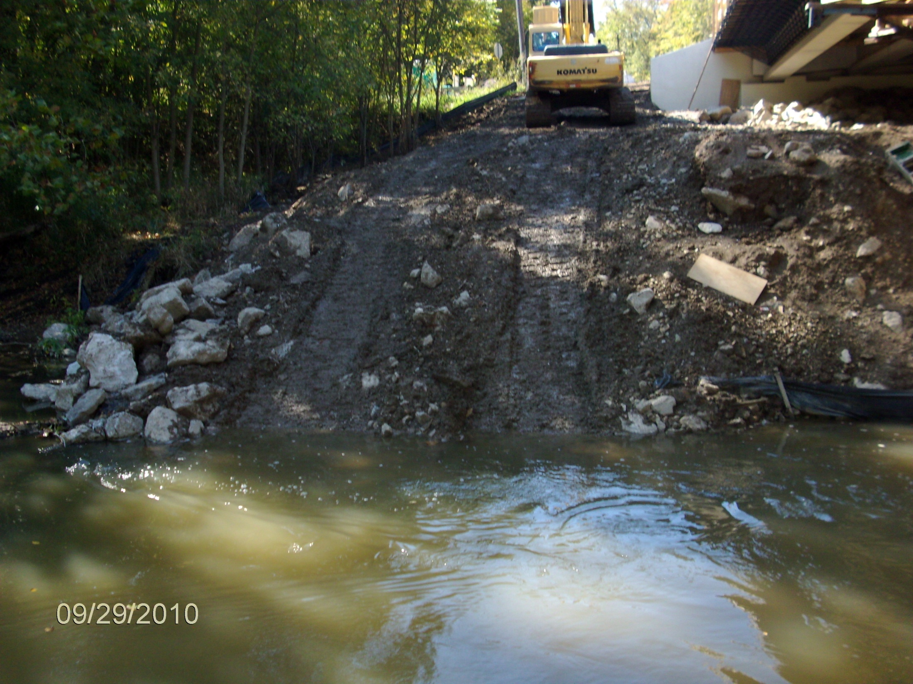
832.06 Causeways and Access Fills (Stream and River Crossings and Fills). Fording of streams and rivers is not allowed.

Slide 12
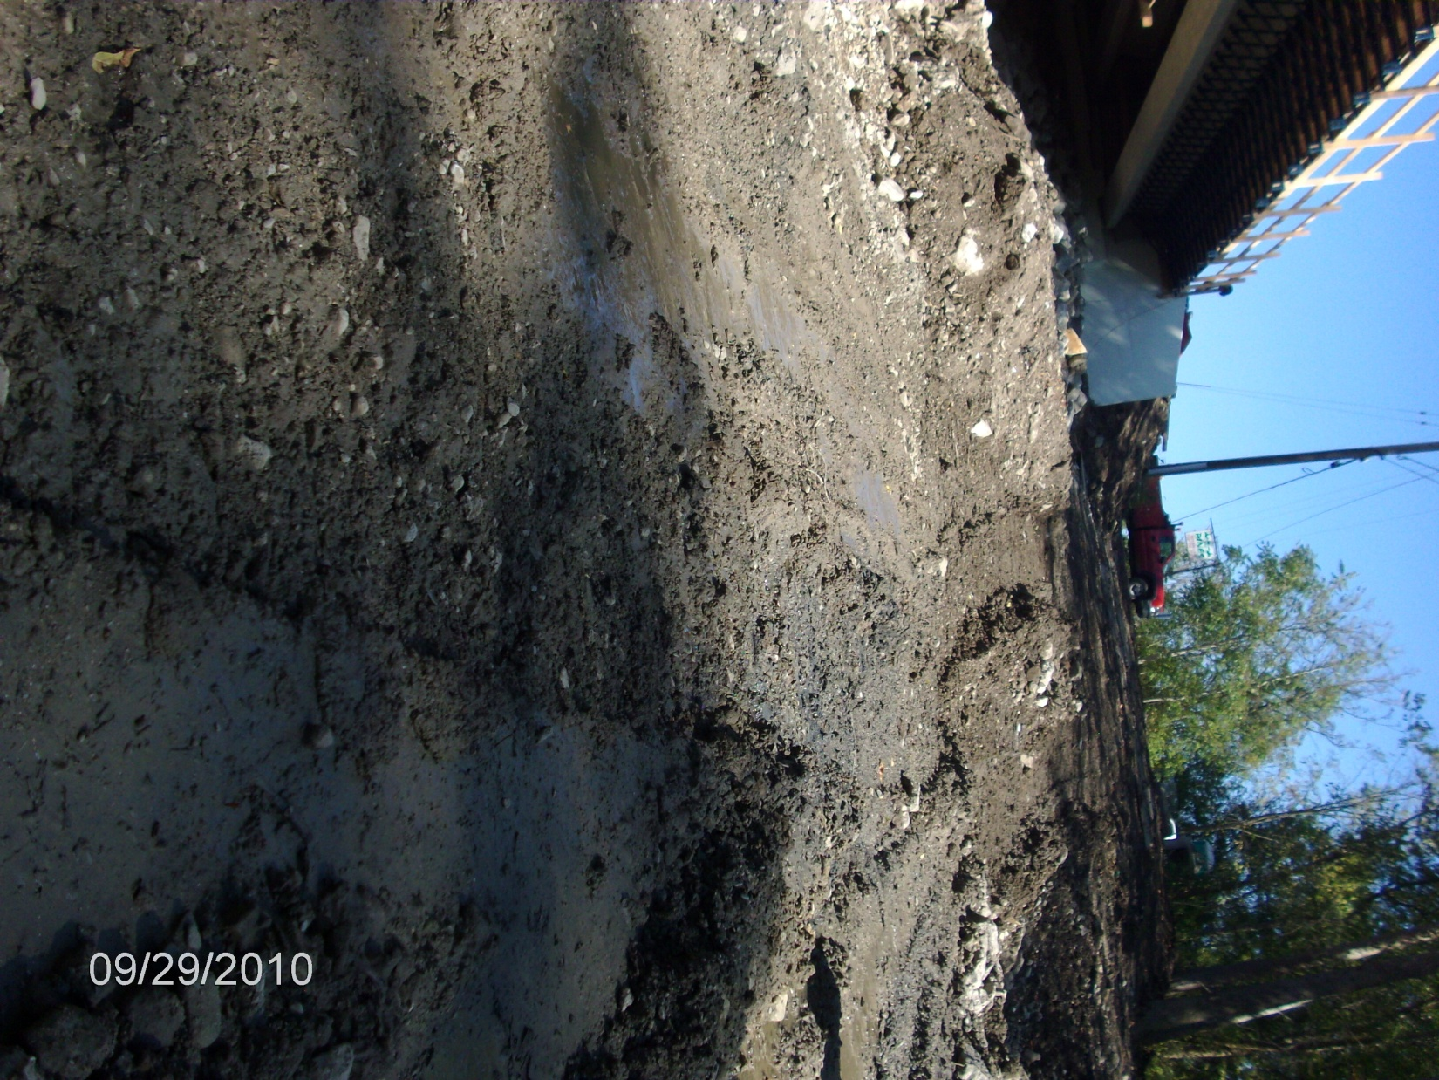
832.07 Causeway and Access Fills Construction and Payment
For all fill and surface material placed in the channel, around the culverts, or on the surface of the causeway and access fills furnish clean, non-erodible, nontoxic dumped rock fill, Type B, C or D, as specified in C&MS 703.19.B. Extend rock fill up the slope from original stream bank for 50 feet (10 m) to catch and remove erodible material from equipment.

Slide 13
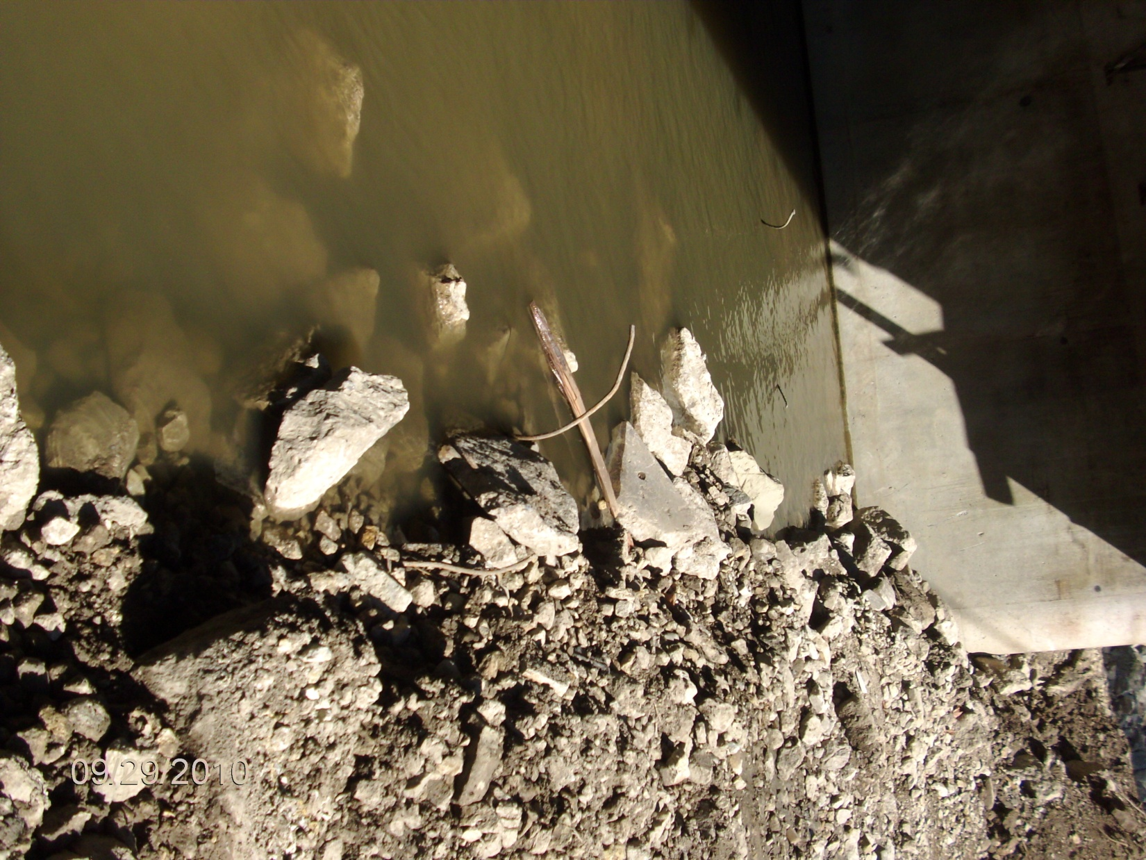
For all fill and surface material placed in the channel, around the culverts, or on the surface of the causeway and access fills, furnish clean, non-erodible, nontoxic, dumped rock fill, Type B, C or D, as specified in C&MS 703.19.B.
703.19 B Dumped Rock Fill and Rock Channel Protection
Do not use RPCC with reinforcing steel protruding more than 1 inch (25 mm) beyond the outside surface of the concrete pieces.

Slide 14
Reoccurring Deficiencies
Jurisdictional boundaries identified in the field (as required)
Exposed Reinforcing steel
Temp fill consisting of erodible material…encapsulation
Extent of the permitted fill is reasonably close to the limits described in the permit (volume and footprint)

